Slide 1
Reprezentare grafica a algoritmului roy-floyd
Andrei Niculae

Slide 2
Demo time

Slide 3
Roy – Floyd
int i, j, k;
for (k = 0; k < nodes.size(); k++)
for (i = 0; i < nodes.size(); i++)
for (j = 0; j < nodes.size(); j++)
if (a[i][k] && a[k][j] && (a[i][j] > a[i][k] + a[k][j] || !a[i][j]) && i != j)
a[i][j] = a[i][k] + a[k][j];

Slide 4


Slide 5
Simple Fast Multimedia Library

Slide 6
Codul

Slide 7
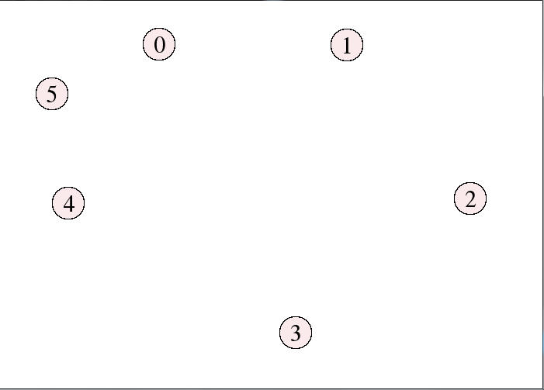
Ziua 1
std::vector<sf::CircleShape> nodes;
std::vector<sf::Text> indexes; //indecsi
while (window.isOpen())
{
sf::Event event;
while (window.pollEvent(event))
{
if(sf::Event::MouseButtonPressed)
if (event.mouseButton.button == sf::Mouse::Left)
{
draw_node_store_in_vector();
draw_index_store_in_vector();
}
}
window.clear(sf::Color::White);
draw_graph();
window.display();
}

Slide 8
Site SFML
"Calling clear before drawing anything is mandatory, otherwise the contents from previous frames will be present behind anything you draw. The only exception is when you cover the entire window with what you draw, so that no pixel is not drawn to. In this case you can avoid calling clear (although it won't have a noticeable impact on performance).
Calling display is also mandatory, it takes what was drawn since the last call to display and displays it on the window. Indeed, things are not drawn directly to the window, but to a hidden buffer. This buffer is then copied to the window when you call display -- this is called double-buffering.
This clear/draw/display cycle is the only good way to draw things. Don't try other strategies, such as keeping pixels from the previous frame, "erasing" pixels, or drawing once and calling display multiple times. You'll get strange results due to double-buffering. Modern graphics hardware and APIs are really made for repeated clear/draw/display cycles where everything is completely refreshed at each iteration of the main loop. Don't be scared to draw 1000 sprites 60 times per second, you're far below the millions of triangles that your computer can handle."

Slide 9
void draw_node_store_in_vector()
{
sf::CircleShape circle(20.0f); //raza de 20
float radius = circle.getRadius();
circle.setPointCount(100); //explicatii?
circle.setFillColor(sf::Color(251, 234, 235)); //culoarea
circle.setOutlineThickness(1.5f); //marginea
circle.setOutlineColor(sf::Color(0, 0, 0));
circle.setPosition(sf::Vector2f(sf::Mouse::getPosition(window))); //pozitia cercului = pozitia mousului
circle.setOrigin(radius, radius);
nodes.push_back(circle); //il bag in vectorul nodes
}
void draw_index_store_in_vector()
{
sf::Text index;
index.setFont(font);
index.setString(std::to_string(indexes.size()));
index.setCharacterSize(30);
index.setFillColor(sf::Color::Black);
index.setOrigin(7.f, 19.f);
index.setPosition(sf::Vector2f(sf::Mouse::getPosition(window)));
indexes.push_back(index);
}

Slide 10
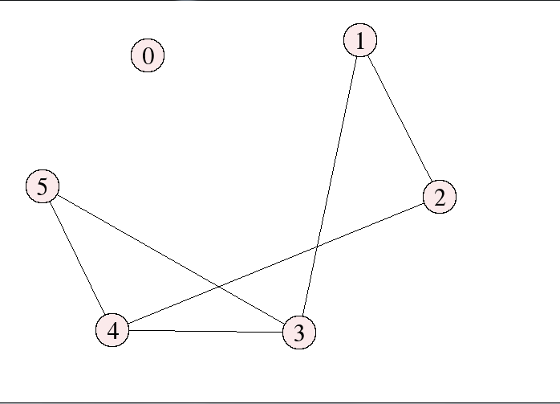
Ziua 2
if (event.key.code == sf::Keyboard::M)
for (int i = 0; i < nodes.size(); i++)
{
pos.push_back(nodes[i].getPosition());
}
for (int i = 0; i < pos.size(); i++)
{
for (int j = 0; j < pos.size(); j++)
{
if (a[i][j])
{
draw_edge_store_in_vector(i, j, sf::Color::Black, edges);
}
}

Slide 11
void draw_edge_store_in_vector(int i, int j, sf::Color color, std::vector<sf::VertexArray> &vector)
{
sf::VertexArray line(sf::Lines, 2);
line[0].position = pos[i];
line[0].color = color;
line[1].position = pos[j];
line[1].color = color;
vector.push_back(line);
}

Slide 12
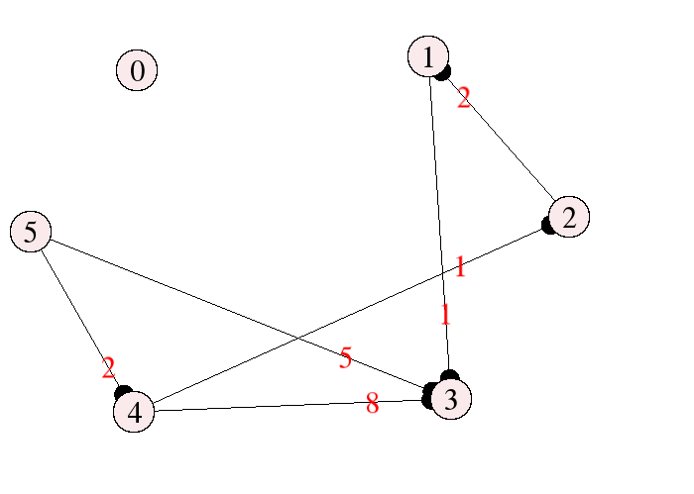
Ziua 3-4
if (event.key.code == sf::Keyboard::M)
for (int i = 0; i < nodes.size(); i++)
{
pos.push_back(nodes[i].getPosition());
}
for (int i = 0; i < pos.size(); i++)
{
for (int j = 0; j < pos.size(); j++)
{
if (a[i][j])
{
draw_edge_store_in_vector(i, j, sf::Color::Black, edges);
draw_costs_store_in_vector(i, j, a, sf::Color::Red);
draw_direction_store_in_vector(i, j, sf::Color::Black, directions);
}
}

Slide 13
void draw_costs_store_in_vector(int i, int j, int mat[101][101], sf::Color color)
{
sf::Text cost;
cost.setFont(font);
cost.setString(std::to_string(mat[i][j]));
cost.setCharacterSize(30);
cost.setFillColor(color);
cost.setOrigin(7.f, 19.f);
cost.setPosition(pos[i].x + (3 * (pos[j].x - pos[i].x) / 4), pos[i].y + (3 * (pos[j].y - pos[i].y) / 4));
costs.push_back(cost);
}
void draw_direction_store_in_vector(int i, int j, sf::Color color, std::vector<sf::CircleShape> &vector)
{
sf::CircleShape circle(10.0f);
float radius = circle.getRadius();
circle.setPointCount(100);
circle.setFillColor(color);
float slope2 = atan2(pos[j].y - pos[i].y, pos[j].x - pos[i].x); //TRIGONOMETRY, IS THAT YOU?
int offset = 20;
circle.setPosition(pos[j].x - offset * cos(slope2), pos[j].y - offset * sin(slope2)); //YES IT IS
circle.setOrigin(radius, radius);
vector.push_back(circle);
}

Slide 14
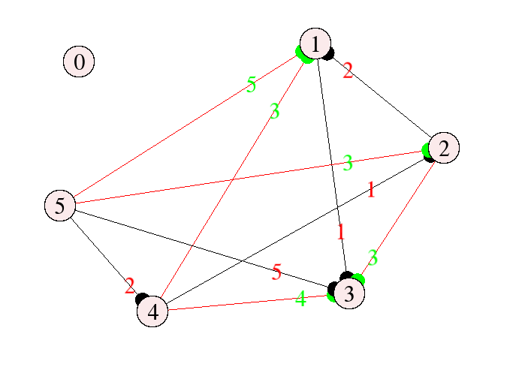
Ziua 5
for (int i = 0; i <= nodes.size(); i++)
for (int j = 0; j <= nodes.size(); j++)
{
if (a[i][j])
{
if (a[i][j] != b[i][j])
{
draw_costs_store_in_vector(i, j, a, sf::Color::Green);
draw_edge_store_in_vector(i, j, sf::Color::Red, edges);
draw_direction_store_in_vector(i, j, sf::Color::Green, directions);
}
else
{
draw_costs_store_in_vector(i, j, a, sf::Color::Red);
draw_edge_store_in_vector(i, j, sf::Color::Black, edges);
draw_direction_store_in_vector(i, j, sf::Color::Black, directions);
}

Slide 15
Ziua 6-7

Slide 16
//Roy-Floyd
int i, j, k;
for (i = 0; i < nodes.size(); i++)
{
for (j = 0; j < nodes.size(); j++)
{
for (k = 0; k < nodes.size(); k++)
{
window.clear(sf::Color::White);

Slide 17
//valori temporare pentru imaginea curenta
draw_edge_store_in_vector(i, k, sf::Color::Green, temp_edges);
draw_edge_store_in_vector(k, j, sf::Color::Green, temp_edges);
draw_edge_store_in_vector(i, j, sf::Color::Red, temp_edges);
if (i != j && i != k && k != j)
{
draw_direction_store_in_vector(i, k, sf::Color::Green, temp_directions);
draw_direction_store_in_vector(k, j, sf::Color::Green, temp_directions);
draw_direction_store_in_vector(i, j, sf::Color::Red, temp_directions);
}
nodes[i].setOutlineColor(sf::Color::Red);
nodes[j].setOutlineColor(sf::Color::Red);
nodes[k].setOutlineColor(sf::Color::Green);
nodes[i].setOutlineThickness(5.0f);
nodes[j].setOutlineThickness(5.0f);
nodes[k].setOutlineThickness(5.0f);

Slide 18
draw_graph(); //functie care deseneaza toate elementele din vectorii cu forme, indecsi, muchii, costuri
sf::sleep(waitTime); //Practic cea mai importanta functie din tot programul
window.display();
if (a[i][k] && a[k][j] && (a[i][j] > a[i][k] + a[k][j] || !a[i][j]) && i != j)
{
a[i][j] = a[i][k] + a[k][j];
sf::sleep(solutionWaitTime); //Timp de asteptare pentru a vedea solutia
}

Slide 19

Multumesc ca m-ati ascultat
uite o poza cu un arici

